Slide 1

MAPPING EUROPEAN POLITICAL PARTIES
Unsupervised Learning Project for Statistical Learning
Author: Marco Cazzola

Slide 2
RESEARCH QUESTIONS
Where would national parties locate in a political compass?
Is there a correspondence between EU parliamentary membership and the parties’ position in that political compass?

Slide 3
1.
DATA SUMMARY
Features definition

Slide 4


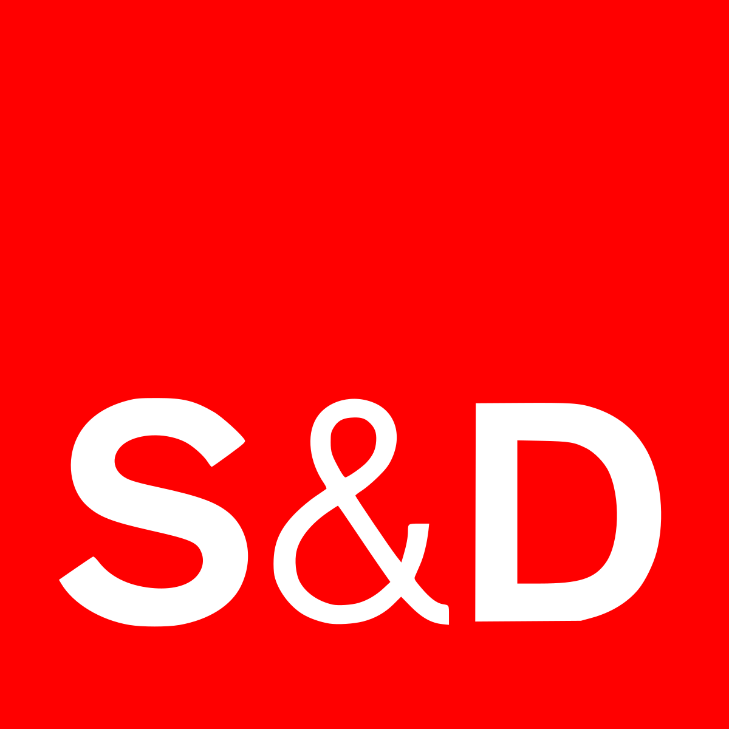




EU MEMBERSHIP
Left-wing groups
Centre-left groups
Centre-right groups
Right-wing groups

Slide 5

ECONOMY
REDISTRIBUTION
0 = strongly favors redistribution
10 = strongly opposes redistribution
SPENDVTAX
0 = strongly favors improving public services
10 = strongly favors reducing taxes
DEREGULATION
0 = strongly opposes deregulation of markets
10 = strongly favors deregulation of markets
PROTECTIONISM
0 = strongly favors trade liberalization
10 = strongly favors protection of domestic producers
ECON_INTERVEN
0 = fully in favor of state intervention in the economy
10 = fully opposed to state intervention in the economy

Slide 6

GLOBALIZATION
ETHNIC_MINORITIES
0 = strongly supports more rights for ethnic minorities
10 = strongly opposes more rights for ethnic minorities
IMMIGRATE_POLICY
0 = strongly favors a liberal policy on immigration
10 = strongly favors a restrictive policy on immigration
MULTICULTURALISM
0 = strongly favors multiculturalism
10 = strongly favors assimilation of immigrants
NATIONALISM
0 = strongly promotes cosmopolitanism
10 = strongly promotes nationalism

Slide 7

CULTURAL VALUES
CIVLIB_LAWORDER
0 = strongly promotes civil liberties
10 = strongly promotes tough measures to fight crime
SOCIAL LIFESTYLE ¹
0 = strongly supports liberal policies
10 = strongly opposes liberal policies
GALTAN
0 = Libertarian/Postmaterialist
10 = Traditional/Authoritarian
RELIGIOUS_PRINCIPLES
0 = strongly opposes religious principles in politics
10 = strongly supports religious principles in politics
¹ For example, how much a party supports women and homosexuals rights.

Slide 8

OTHER ISSUES
ENVIRONMENT
0 = favors environmental protection over economic growth
10 = favors economic growth over environmental protection
EU_POSITION
1 = strongly opposes EU integration
7 = strongly favors EU integration
REGIONS
0 = strongly favors political decentralization
10 = strongly opposes political decentralization
URBAN_RURAL
0 = strongly supports urban interests
10 = strongly supports rural interests

Slide 9
2.
DESCRIPTIVE STATISTICS
Preliminary analysis

Slide 10
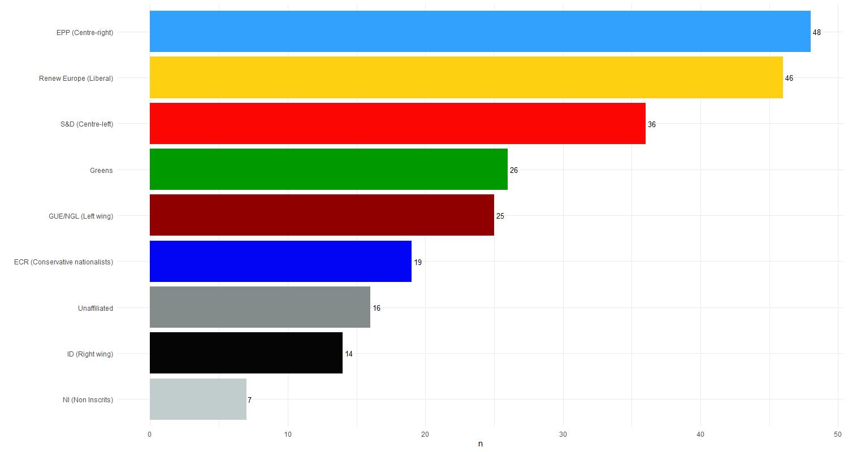
GROUPS CARDINALITY

Slide 11

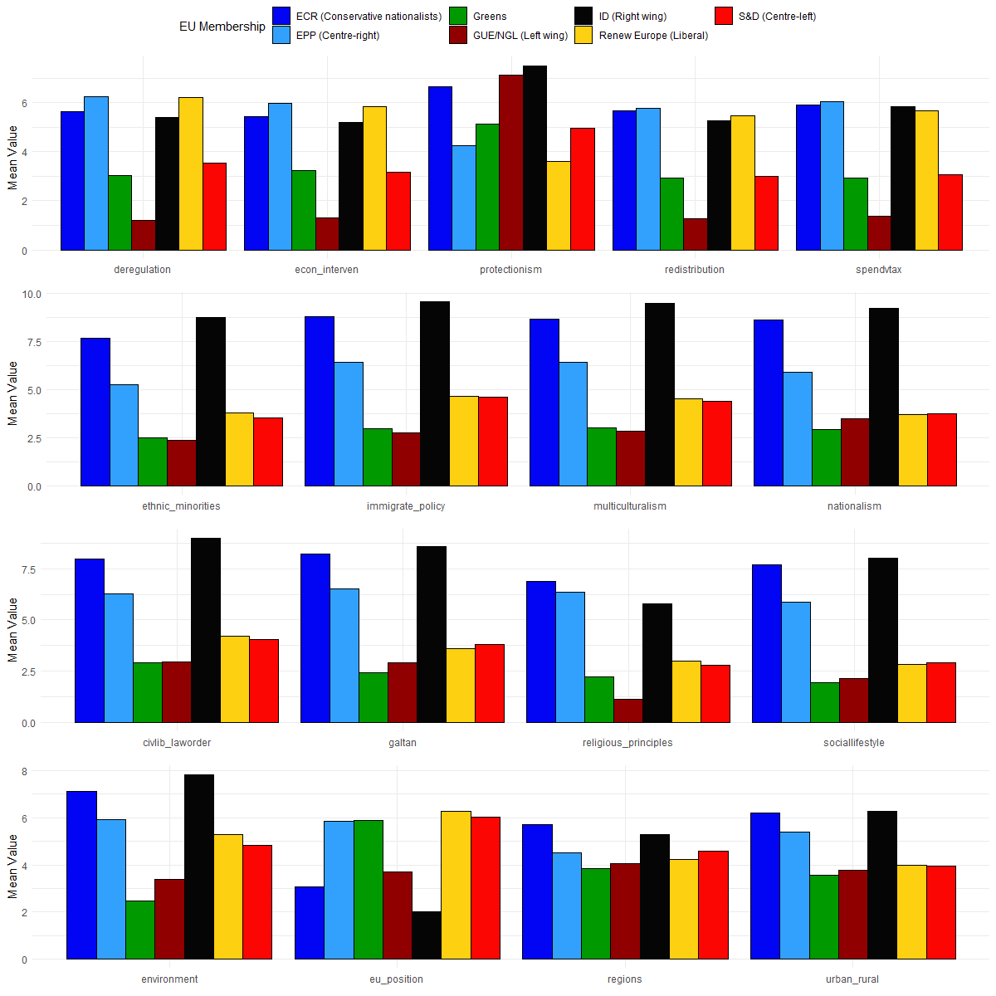
DISTRIBUTIONS / 1

Slide 12
DISTRIBUTIONS / 2

Slide 13

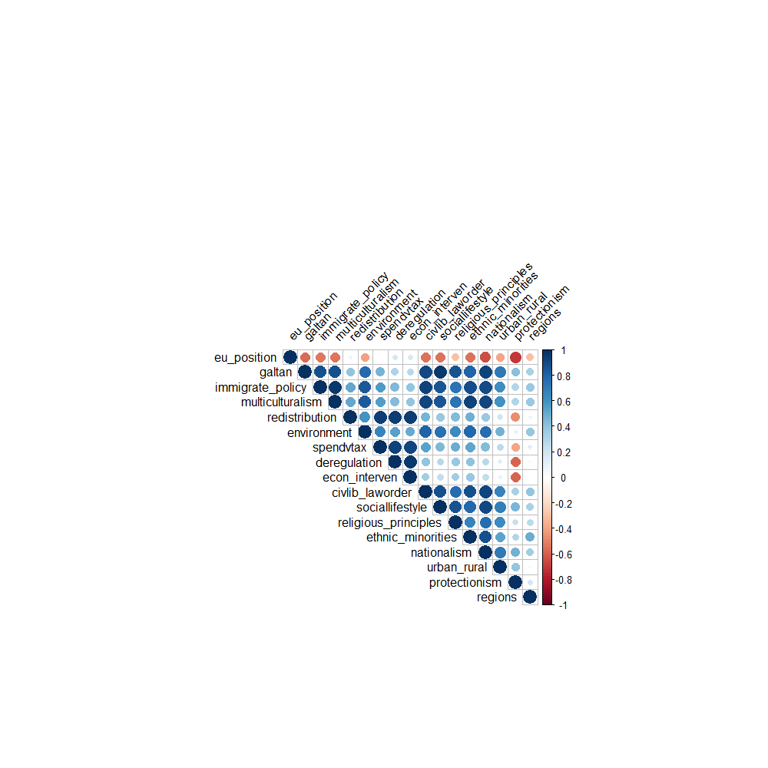
CORRELATION MATRIX

Slide 14
3.
PRINCIPAL COMPONENT ANALYSIS
Data dimensionality reduction

Slide 15

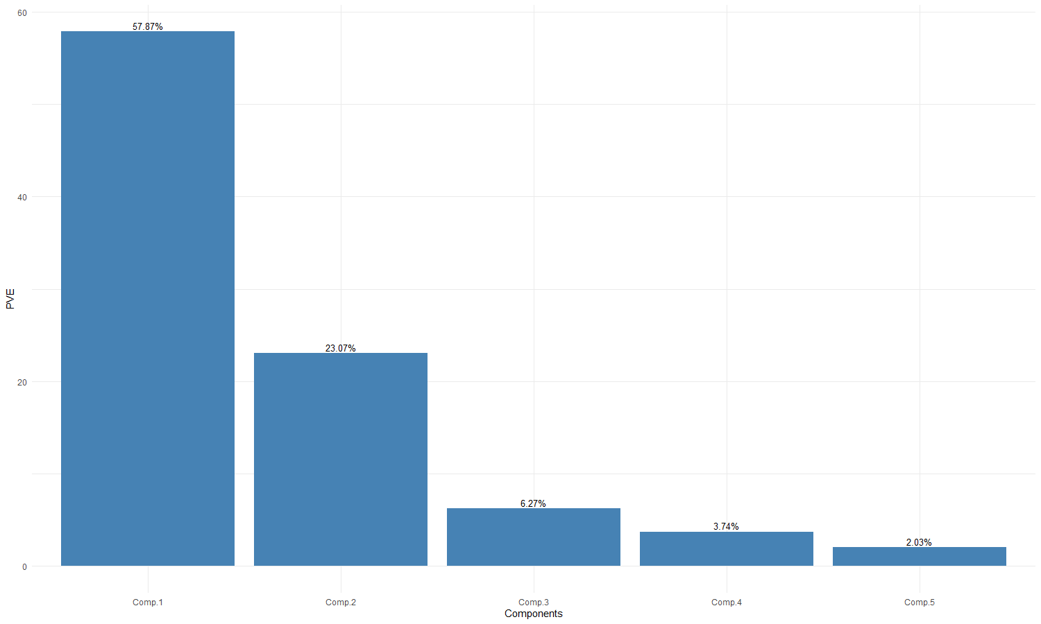
VARIANCE EXPLAINED
57,87%
23,07%
6,27%
3,74%
2,03%

Slide 16

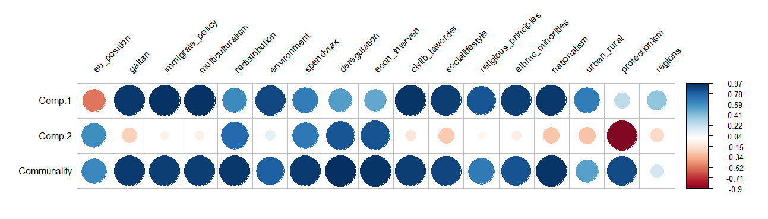
COMPONENTS INTERPRETATION

Slide 17

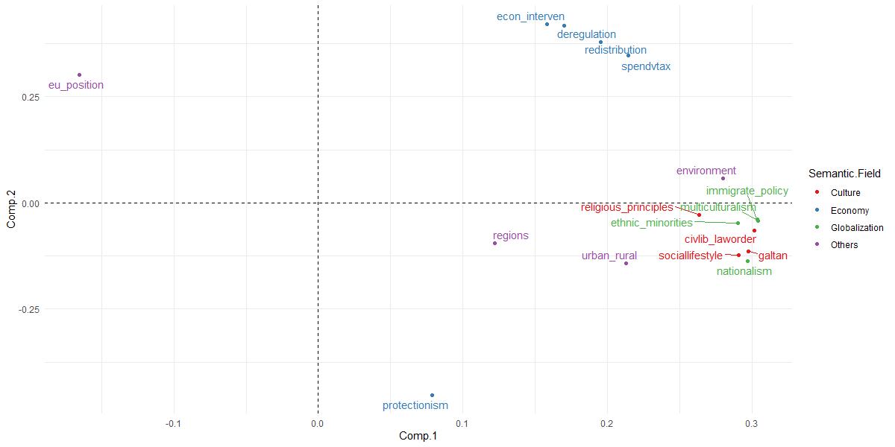
LOADINGS PLOT

Slide 18
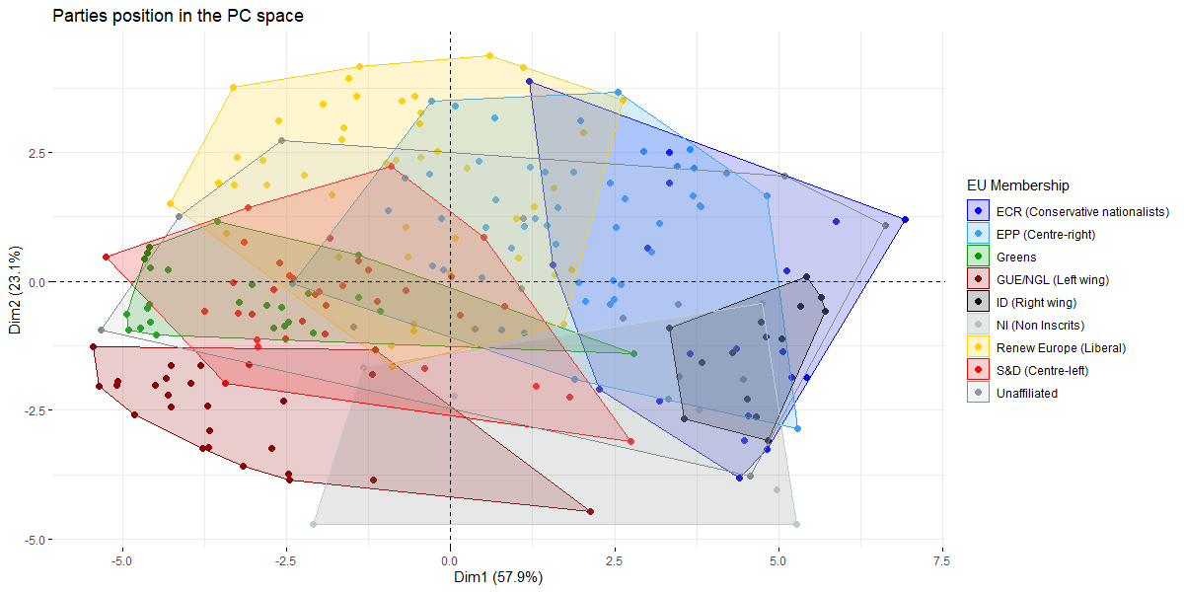
SCORES PLOT

Slide 19
4.
K-MEANS
Clustering EU political parties

Slide 20
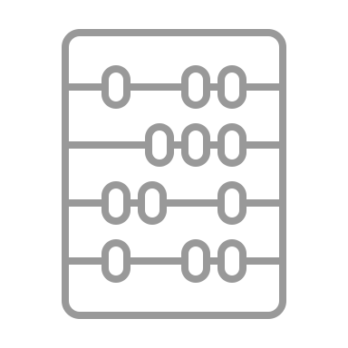
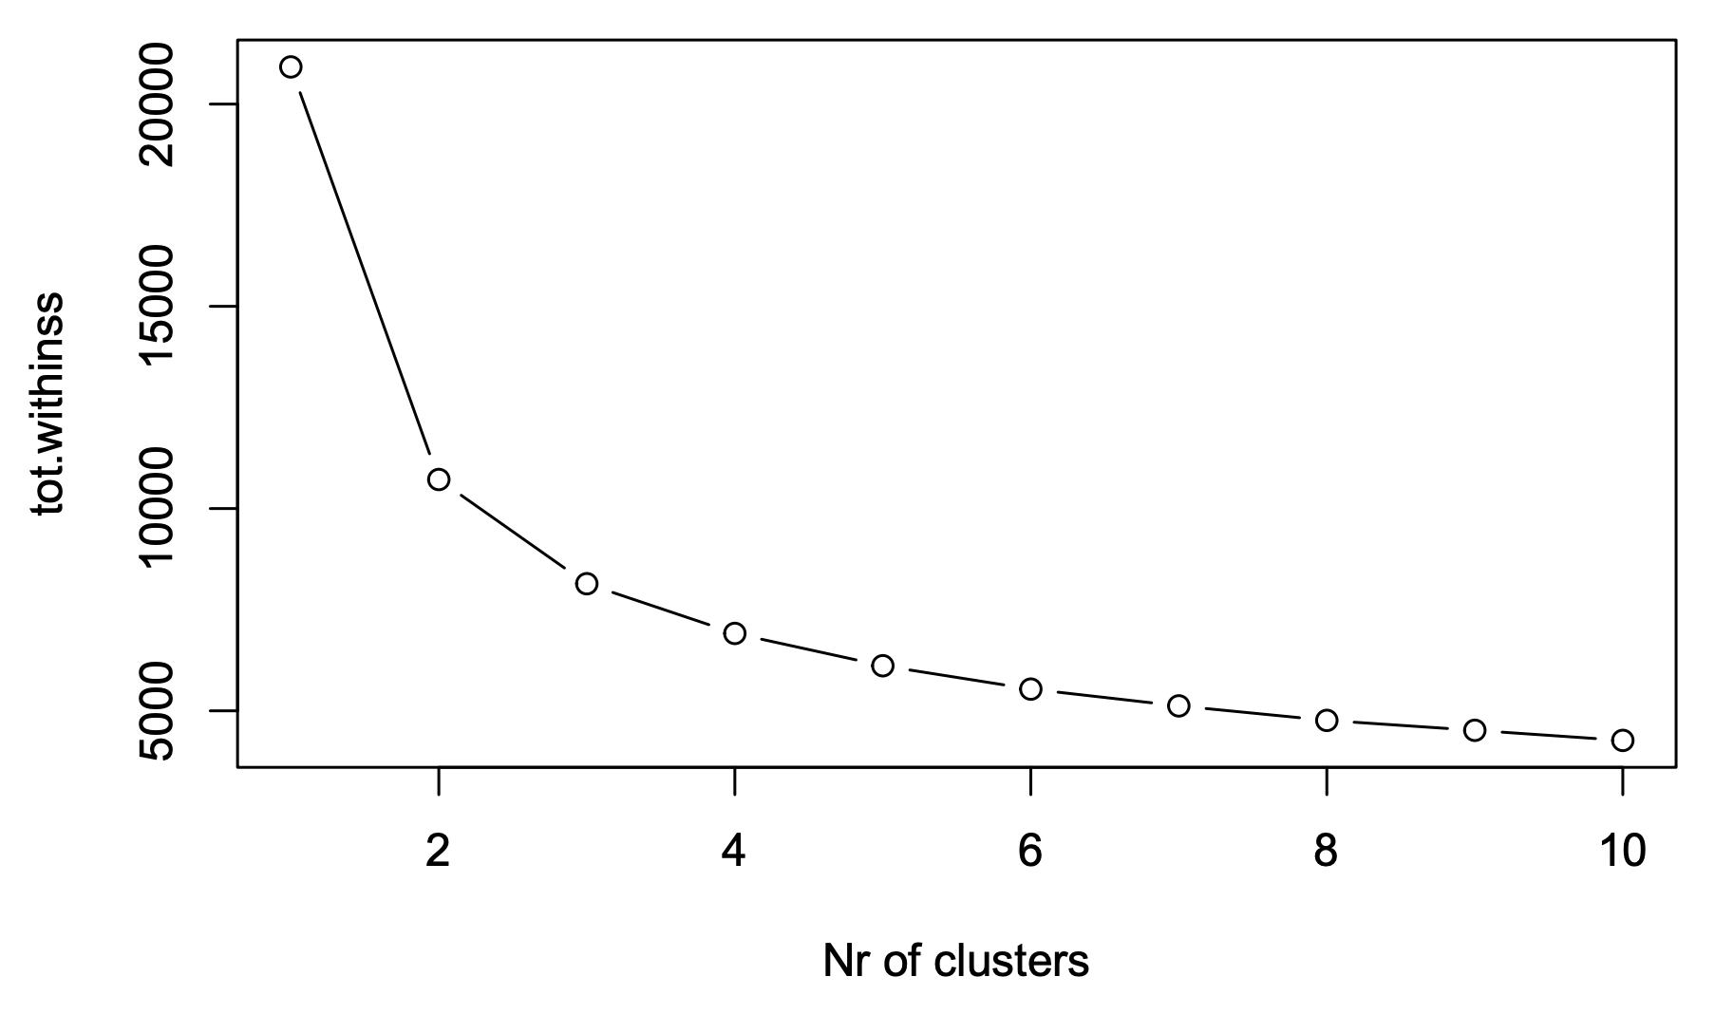
SELECTING K

Slide 21

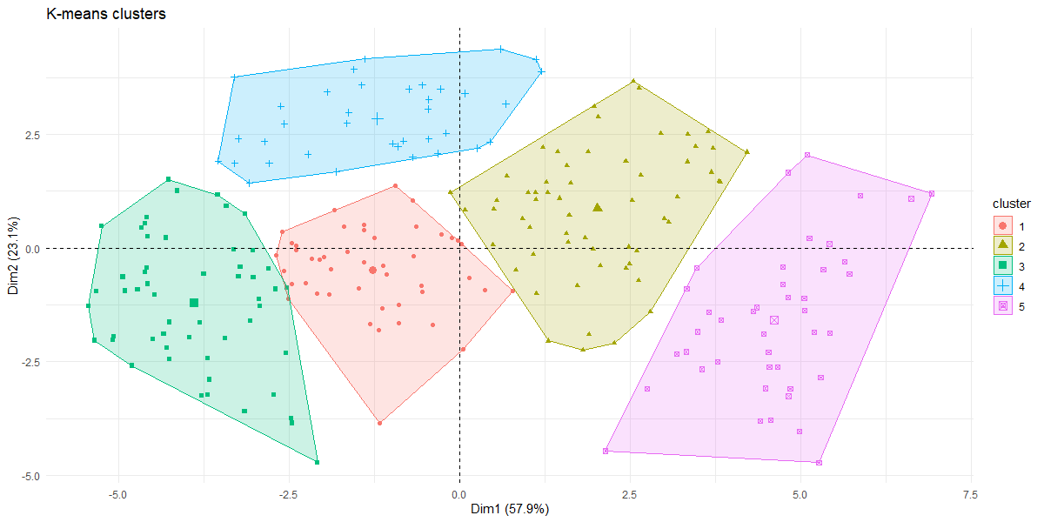
CLUSTERS

Slide 22

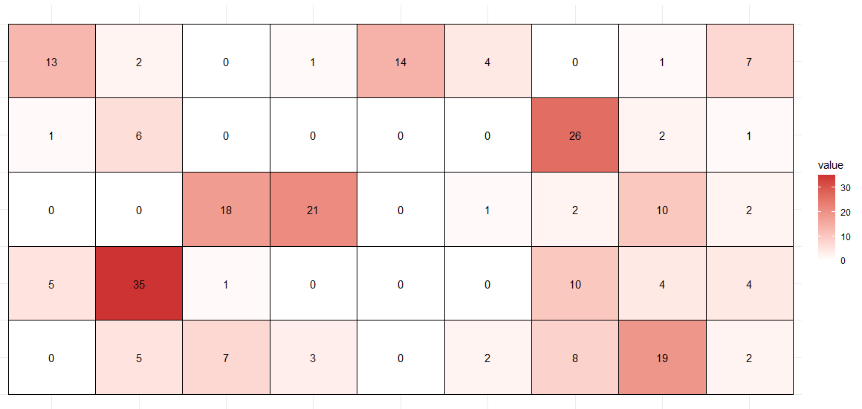
EU MEMBERSHIP CORRESPONDENCE
5
4
3
2
1
ECR
EPP
Greens
GUE/NGL
ID
Non-Inscrits
Renew Europe
S&D
Unaffiliated

Slide 23
5.
HIERARCHICAL CLUSTERING
Clustering EU political parties

Slide 24

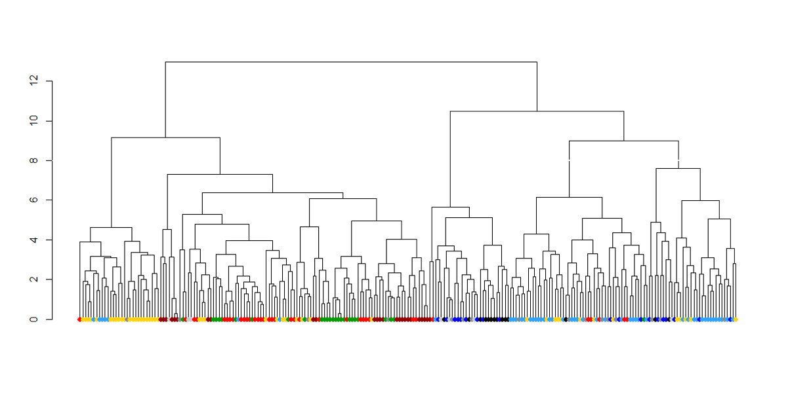
DENDROGRAM

Slide 25
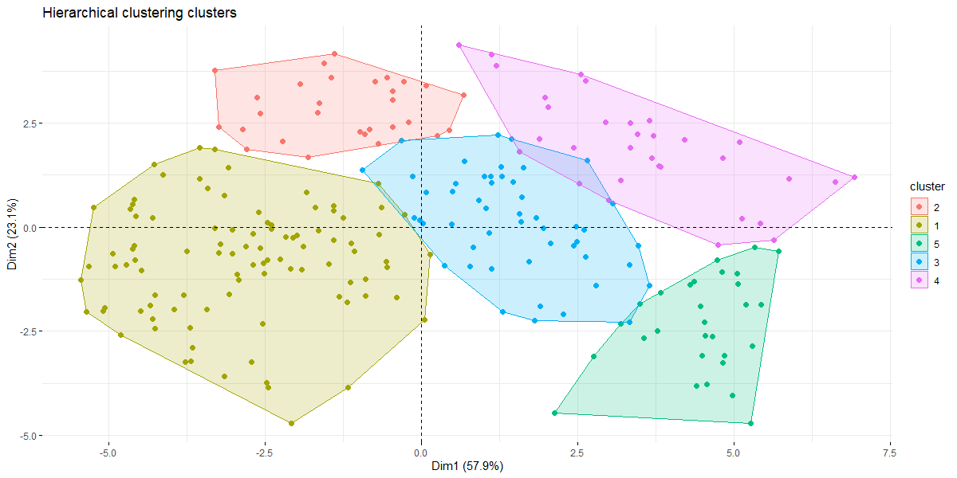
CLUSTERS

Slide 26
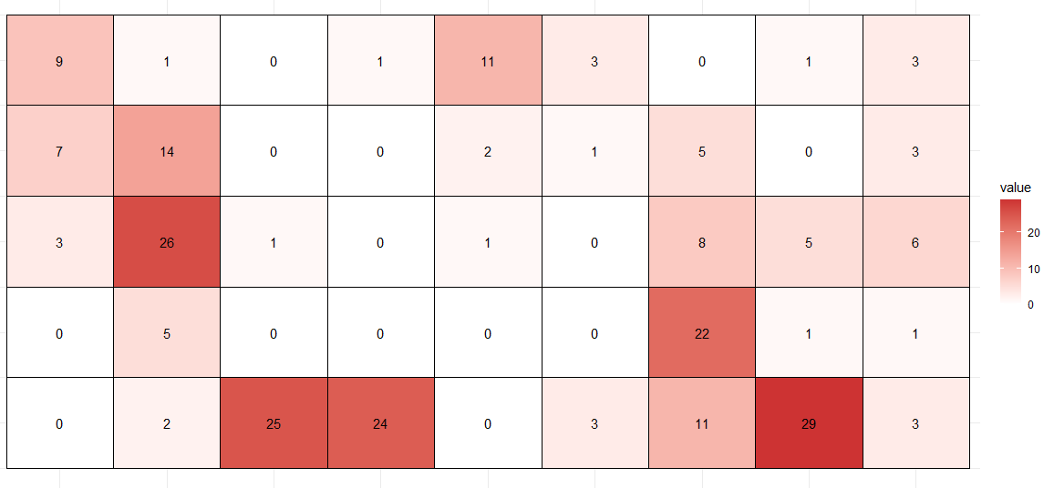
EU MEMBERSHIP CORRESPONDENCE
5
4
3
2
1
ECR
EPP
Greens
GUE/NGL
ID
Non-Inscrits
Renew Europe
S&D
Unaffiliated

Slide 27
6.
CONCLUSION
Comparison & Key findings

Slide 28
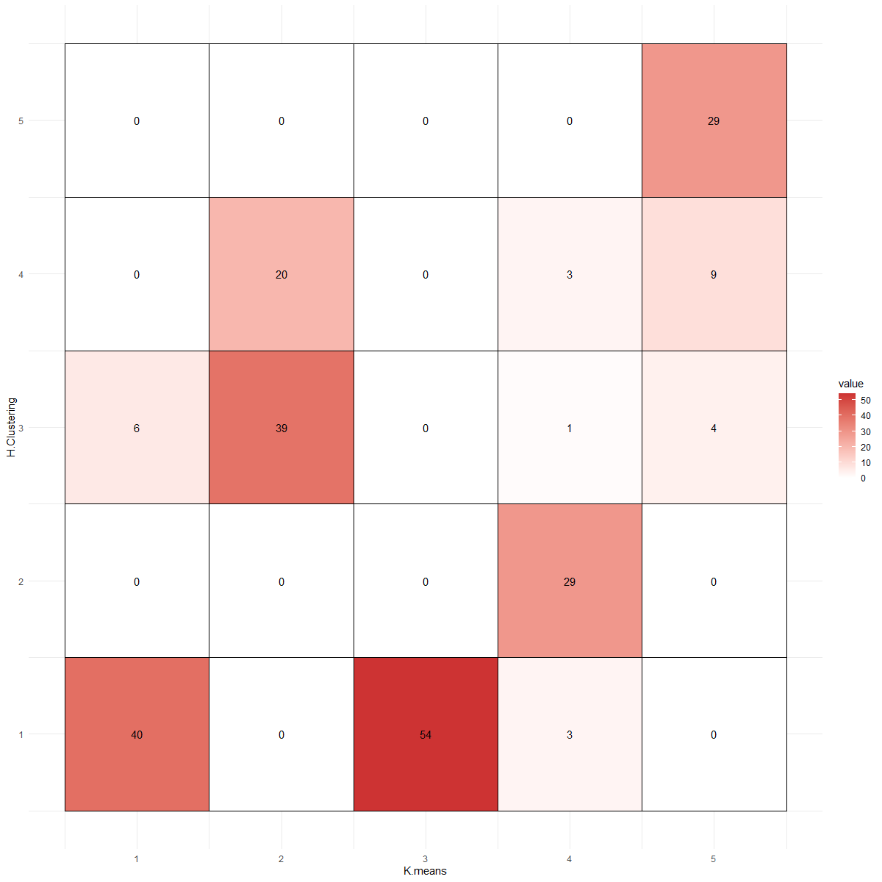
K-MEANS vs HIERARCHICAL CLUSTERING
5
0
0
0
0
29
4
0
20
0
3
9
Hierarchical Clustering
6
0
1
4
3
39
2
0
0
0
29
0
1
40
0
54
3
0
1
2
3
4
5
K-Means

Slide 29
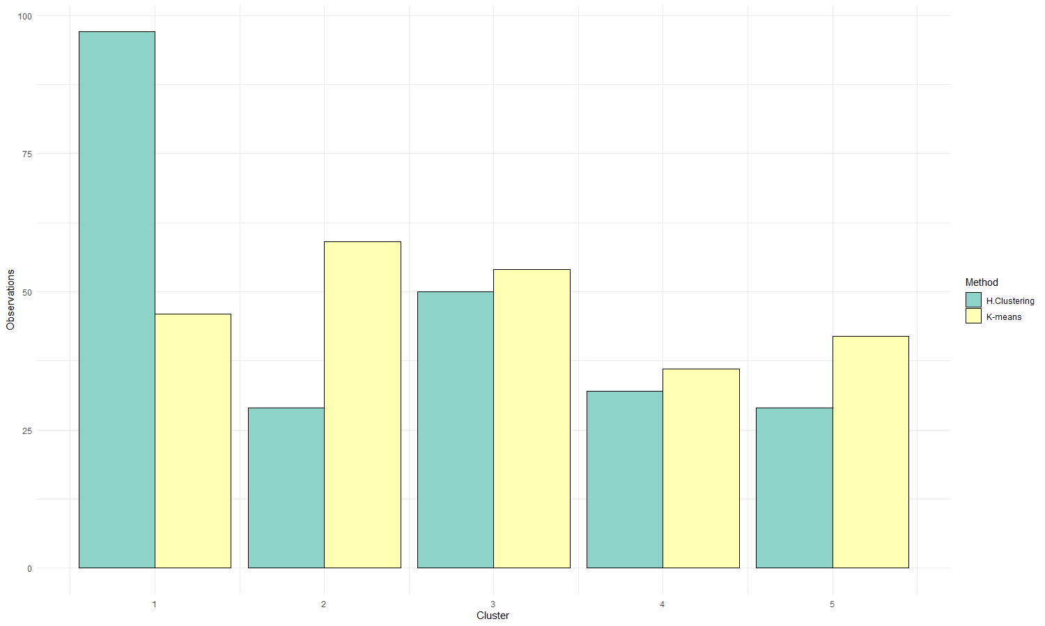
CLUSTERS CARDINALITY
97
59
54
K-Means
50
46
42
36
29
32
29
H. Clustering

Slide 30

FINAL COMPARISON
In our case, K-means produced more balanced and more interpretable clusters than hierarchical clustering.
In both cases, 5 clusters seemed enough to adequately cluster the parties.

Slide 31

KEY FINDINGS
In the same way, more ‘extremist’ parties are very different in terms of cultural values, but they have similar (interventionist) views on the economy.
Finally, liberals tend to cluster on the progressive side of cultural values, while being conservative for what concerns the economy.
Moderate parties are more different in terms of cultural values (first PC) than in terms of economic views (second PC).

Slide 32
THANKS FOR WATCHING!

